Slide 1
Database Management Systems
Lesson 1 – Introduction
B.R.Madhurangi
..

Slide 2
Assessment & Weighting
In class assignments 20%
Mysql Practical Assignment 20%
Group Project-20%
End of semester examination Structured examination paper 40%

Slide 3
Outline Syllabus
Basic concepts
Database Architectures
Database design
Relational Database systems
Database Normalization
Physical Database implementation-(Mysql Practical)

Slide 4
Lesson 1 - Introduction
Sub Topics
Data , Information & Processing
Types of Databases
Problems of File base data processing
History of Database Systems

Slide 5



Data ,information & processing
Processing
Today:- 2013/05/06
DOB :-1990/05/06
23-0-0
Data processed
DOB:-1990/05/06
AGE:23
c
Data
Information
Raw material
processing
Final product

Slide 6
What is Data?
Data is a stream of raw facts representing things or events that have happened.
In ICT, we usually say that data is made up from four basic types:
Numbers
Text
Images
Sound

Slide 7
What is Information?
Information is data that has been processed to make it meaningful and useful
Data + Meaning = Information

Slide 8

Data vs. Information
0
Data
raw facts
no context
Useless
Before processed
No value-added
just numbers and text etc .. without meaning
Information
Final result
with context
Useable
processed data
value-added to data
Summarized, organized, Analyzed
just numbers and text etc .. with meaning

Slide 9
DATABASE
DEFINITION
A shared collection of logically related data designed to meet the information requirements of an organisation.

Slide 10
Types of Databases
Manual file Processing (paper based)
Time Consuming
Does not support large volumes of data
File based Processing
Database Management system
Notes:
Emphasize the idea that a computer file system stores data in independent, unrelated files on disk. The sharing, security and integrity of the data can't be enforced efficiently because of data dependence and data redundancy problems.

Slide 11
Problem in file based system
Inconsistent data
Data duplication/ Redundancy
Security
Inflexibility
Difficult in accessing the data
Isolation
Limited data sharing
Excessive program maintenance
How do we resolve these problems?

Slide 12
File Based Processing
ID 001
Name mery
Address colombo
TelNo 747374
Marks 34
Data Entry | File Processing
Student System Files
ID 001
Name mery
Address colombo
TelNo 747374
Books-bor 6
Data Entry | File Processing
Data Duplication
Library System Files
Notes:
Same data in two different place

Slide 13
File Based Processing
ID 001
Name mery
Address colombo
TelNo 747374
Marks 34
Change request
Data Entry | File Processing
Student System Files
ID 001
Name mery
Address colombo
TelNo 747374
Books-bor 6
Data Entry | File Processing
Library System Files
Notes:
This diagram shows two departments sales and leases with each department having their own set of files and programs written for them. The really important point about this is that the physical structure and storage of the data files are defined in the program code.
E.g. COBOL - data is defined in the data section of the program

Slide 14
File Based Processing
ID 001
Name mery
Address Kandy
TelNo 747374
Marks 34
Address Change request
Data Entry | File Processing
Student System Files
ID 001
Name mery
Address colombo
TelNo 747374
Books-bor 6
Data Entry | File Processing
Inconsistent Data
Library System Files
Notes:
This diagram shows two departments sales and leases with each department having their own set of files and programs written for them. The really important point about this is that the physical structure and storage of the data files are defined in the program code.
E.g. COBOL - data is defined in the data section of the program

Slide 15
Solution is DBMS
DBMS is solution to rectify file based processing problems
A software system that enables users to define, create and maintain the database and which provides controlled access to the database
User Query
DBMS
(processing)
Store the data with well organized form
Retrieve the data by user query
Information distribution
Data Collection
Database

Slide 16
Why DBMS?
Suppose we need to develop a Information system.
How do we
store the data? (use file structures…)
query the data? (write programs…)
Update data safely? (write more programs…)
provide different views on the same data?
(staff & students different)
deal with crashes?
DBMS helps to above activities.

Slide 17

What is a Database System?
Database System = Database + DBMS
A Database is
A large, integrated collection of data
Models (represents) a real-world enterprise.
Entities (e.g., students, courses)
Relationships (e.g., Mary takes CS123)
A Database Management System (DBMS) is
A software package designed to store and
Manages databases easily and efficiently.

Slide 18
History of Database Systems
1950s and early 1960s:
Data processing using magnetic tapes for storage
Tapes provide only sequential access
Punched cards for input
Late 1960s and 1970s:
Hard disks allow direct access to data
Network and hierarchical data models in widespread use
Ted Codd defines the relational data model
Would win the ACM Turing Award for this work
IBM Research begins System R prototype
UC Berkeley begins Ingres prototype
High-performance (for the era) transaction processing

Slide 19
History (cont.)
1980s:
Research relational prototypes evolve into commercial systems
SQL becomes industry standard
Parallel and distributed database systems
Object-oriented database systems
1990s:
Large decision support and data-mining applications
Large multi-terabyte data warehouses
Emergence of Web commerce
2000s:
XML and XQuery standards
Automated database administration
Increasing use of highly parallel database systems
Web-scale distributed data storage systems

Slide 20
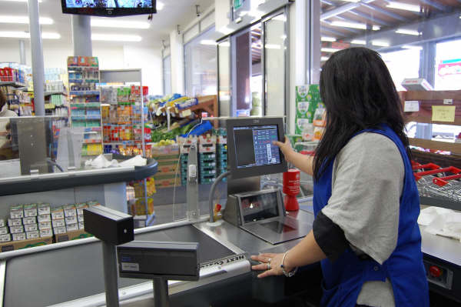
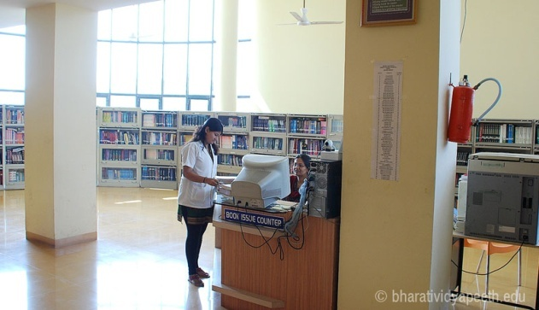
Common Uses of Databases
Try to think why each of these need to use a database:
Supermarkets
Insurance
Credit Cards/Banking
Libraries
Travel Agents
Universities
Notes:
Supermarkets - When you go to do your shopping its usual that a database is accessed. The checkout assistant runs a barcode over your purchases. This is linked to a database which uses the bar code to find out the price of the item from a products database. Then it will reduce the number of items in stock by 1
Insurance - When you buy car insurance, the broker may access several different databases to find the best price for you
Credit cards - Whenever you buy goods using a credit card the assistant may check that you have sufficient credit etc.

Slide 21
Database Users
Users may be divided into
Those who actually use and control the content
(called “Actors on the Scene”)
Those who enable the database to be developed
and the DBMS software to be designed and
implemented (called “Workers Behind the
Scene”).

Slide 22
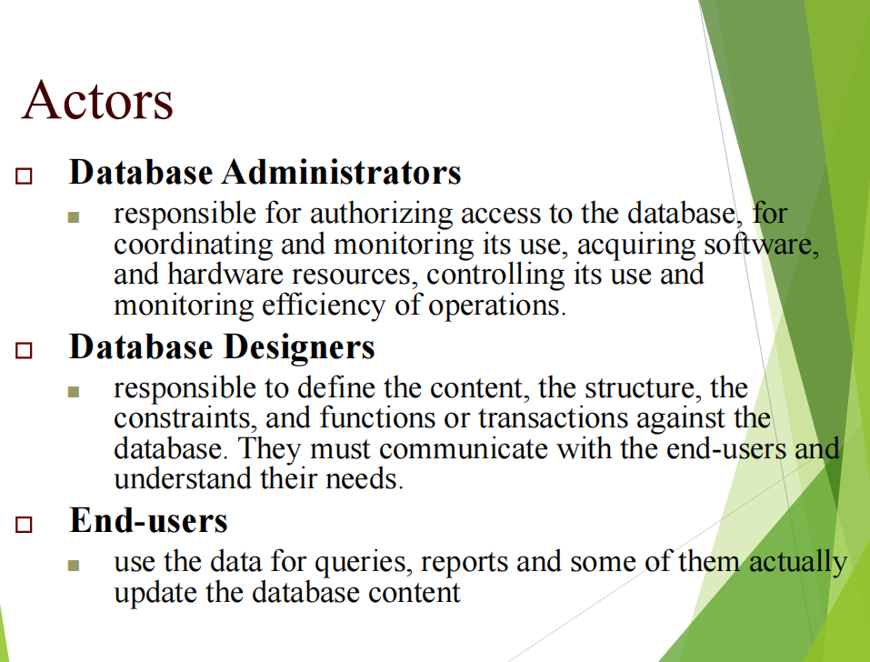

Slide 23
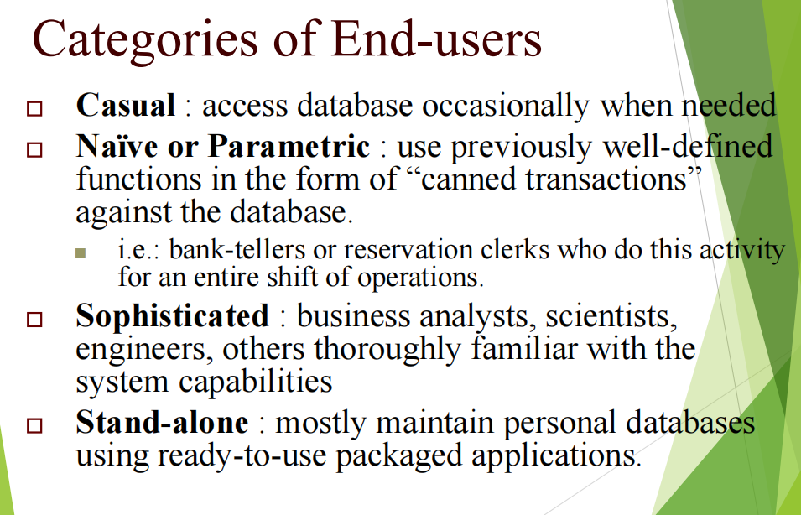

Slide 24
Components of DBMS Environment
Hardware
Can range from a PC to a network of computers.
Software
DBMS, operating system, network software (if necessary) and also the application programs.
Data
Used by the organization and a description of this data called the schema.

Slide 25
Components of DBMS Environment
Procedures
Instructions and rules that should be applied to the design and use of the database and DBMS.
People
Data Administrator (DA), Database Administrator (DBA), Database Designers (Logical and Physical), Application Programmers, End Users (naive and sophisticated)

Slide 26
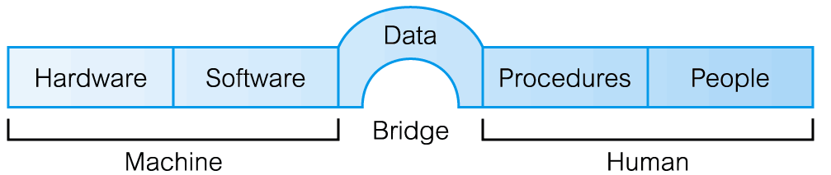
Components of DBMS Environment

Slide 27
Main Characteristics of the Database Approach
Self-describing nature of a database system:
A DBMS catalog stores the description of the database.
called meta-data).
allows the DBMS software to work with different databases.
Database
Raw data
Meta data
Systems Catalog
Notes:
Direct the students' attention to the text's Section 1.4, then discuss how the DBMS functions address each of the file system's problems. Emphasize that a proper database system eliminates data dependence and improves data integrity by minimizing data redundancy. Especially note that the good database design is the key to reaping the rewards of a proper database system. Remind the students that the best programmers and applications developers cannot rescue a database system from the effects of poor database design. (Just as hiring the best bricklayers will not produce a good house from a poor blueprint.)

Slide 28
Insulation between programs and data: Called program-data independence.
Allows changing data storage structures and operations without having to change the DBMS access programs.
Data Abstraction: A data model is used to hide storage details and present the users with a conceptual view of the database.

Slide 29
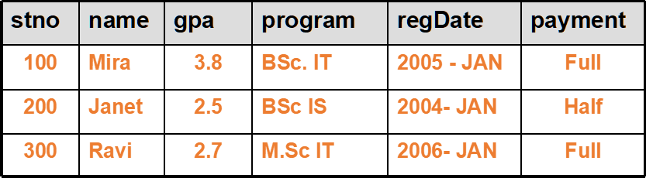
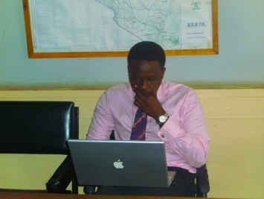
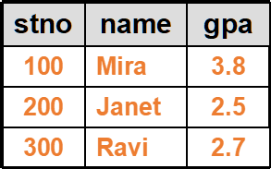
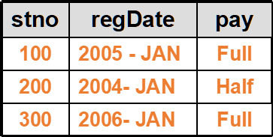

Main Characteristics of the Database Approach
Support of multiple views of the data: Each user may see a different view of the database, which describes only the data of interest to that user.
Lecturer view
Administrative staff view

Slide 30
Main Characteristics of the
Database Approach
contd.
Sharing of data and multi-user transaction processing :
allowing a set of concurrent users
to retrieve and to update the database.
Concurrency control within the DBMS
guarantees that each transaction is correctly
executed or completely aborted. OLTP
(Online Transaction Processing) is a major
part of database applications.

Slide 31
Advantages of Using the Database Approach
Controlling redundancy in data storage and in development and maintenance efforts.
Sharing of data among multiple users.
Restricting unauthorized access to data.
Providing persistent storage for program Objects
Providing Storage Structures for efficient Query Processing
Providing backup and recovery services.
Providing multiple interfaces to different classes of users.
Representing complex relationships among data.
Enforcing integrity constraints on the database.
Drawing Inferences and Actions using rule

Slide 32
When not to use a DBMS
Main costs of using a DBMS
High initial investment and possible need for additional hardware.
Overhead for providing generality, security, concurrency control,
recovery, and integrity functions.
When is a DBMS may be unnecessary?
If the database and applications are simple, well defined, and not
expected to change
If there are stringent real-time requirements that may not be met
because of DBMS overhead
If access to data by multiple users is not required
When is no DBMS may suffice?
If the database system is not able to handle the complexity of data
because of modeling limitations
If the database users need special operations not supported by the
DBMS

